Slide 1
SPLEENOMEGALY By Dr.Mahadevi A.L Assistant Professor Dept of Paediatrics 26-06-2021

Slide 7
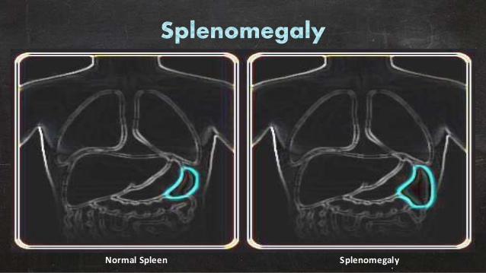

Slide 8
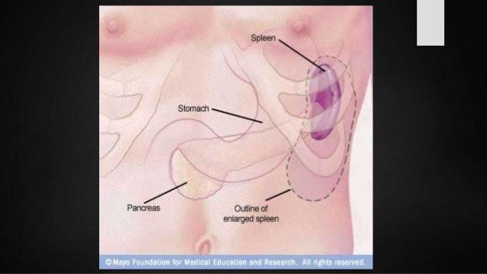

Slide 17
Causes
A number of infections and diseases may cause an enlarged spleen. The enlargement of the spleen may be temporary, depending on treatment. Contributing factors include:
Viral infections, such as mononucleosis
Bacterial infections, such as syphilis or an infection of your heart's inner lining (endocarditis)
Parasitic infections, such as malaria
Cirrhosis and other diseases affecting the liver
Various types of hemolytic anemia — a condition characterized by early destruction of red blood cells
Blood cancers, such as leukemia and myeloproliferative neoplasms, and lymphomas, such as Hodgkin's disease
Metabolic disorders, such as Gaucher's disease and Niemann-Pick disease
Pressure on the veins in the spleen or liver or a blood clot in these veins

Slide 29
Risk factors
Anyone can develop an enlarged spleen at any age, but certain groups are at higher risk, including:
Children and young adults with infections, such as mononucleosis
People who have Gaucher's disease, Niemann-Pick disease, and several other inherited metabolic disorders affecting the liver and spleen
People who live in or travel to areas where malaria is common

Slide 56
Complications
Potential complications of an enlarged spleen are:
Infection. An enlarged spleen can reduce the number of healthy red blood cells, platelets and white cells in your bloodstream, leading to more frequent infections. Anemia and increased bleeding also are possible.
Ruptured spleen. Even healthy spleens are soft and easily damaged, especially in car crashes. The possibility of rupture is much greater when your spleen is enlarged. A ruptured spleen can cause life-threatening bleeding into your abdominal cavity.

Slide 57
Thank U

